Slide 1
Strategic Organizational Excellence
Class 1
Prof. Marwa Tarek

Slide 2
Strategic Organizational Excellence
Strategic organizational excellence is not achieved by chance; it is the result of well-designed managerial efforts that guide the organization toward sustained superior performance.
In today’s highly dynamic and competitive environment, excellence goes beyond operational efficiency to include innovation, adaptability, and long-term value creation.
This is where strategic management plays a central role.

Slide 3
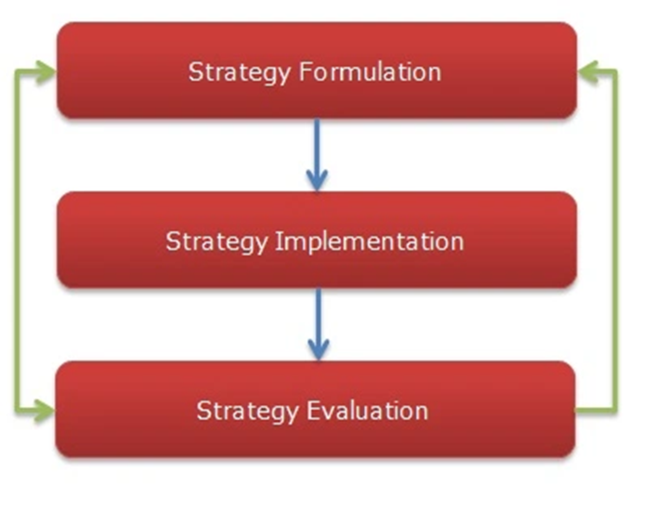
Strategic Organizational Excellence
Strategic Management: Focusing on the formulation, implementation, and evaluation of strategies to achieve long-term organizational goals and sustain competitive advantage.
Strategy is the output of strategic management.

Slide 4
Strategic Organizational Excellence
The Strategy Excellence is about strategy formulation, implementation and evaluation as it relates to your own organization's ability to execute it perfectly.

Slide 5
Strategic Organizational Excellence
Any organization has a set of objectives (ends), which have to be achieved through different means such as plans and strategies.
A plan: is a detailed and structured outline of steps or actions designed to achieve a specific goal or objective.
A strategy is a broader, high-level approach or framework that defines the why and what of achieving long-term goals.
Key Characteristics of a Strategy: Vision-oriented: Focuses on the long-term direction.
WHICH ONE COMES FIRST?

Slide 6
Strategic Organizational Excellence
In a perfect world the strategy always comes before a plan and shapes the details of the plan.
Strategy Comes First
Why? A strategy defines the big picture—the what and why behind achieving a goal.
A plan breaks the strategy into actionable steps—the how, when, and who needed to implement the strategy.

Slide 7
Strategic Organizational Excellence
Strategy without a plan: Direction is clear, but execution may fail due to a lack of structure.
Plan without a strategy: Actions may be efficient but misaligned with long-term goals or the external environment.

Slide 8
Strategic Organizational Excellence
The purpose of the strategy is to achieve the best fit between the organization and its external environment.
To achieve the best fit, I have to deal with 2 sides; the organization and the external environment.
Hence, 2 types of analyses or reviews or assessments should be conducted;
The internal environment, i.e. The organization: (groups of strengths and weaknesses).
The external environment: (groups of opportunities and threats).
SO, the strategy of any organization is based on matching between the internal and external factors.
Whenever I lose the match between these two sides, just we have to expect facing severe problems.

Slide 9
Strategic Organizational Excellence
At any organization we have to have a clear strategy, but from time to time, such strategy must be reviewed. Why?????????

Slide 10
Strategic Organizational Excellence
Because it is expected that many changes may take place whether in the organization or in the external environment. Hence, the current strategy may modified or even changed completely. Especially, the external environment is characterized as (a dynamic environment).
So, if any critical change takes place in the dynamic external environment, it should followed by the suitable change in the strategy to cope with this change.
Consequently, strategic management is a dynamic process as it depends mainly upon dynamic factors (especially the external environment side).

Slide 11
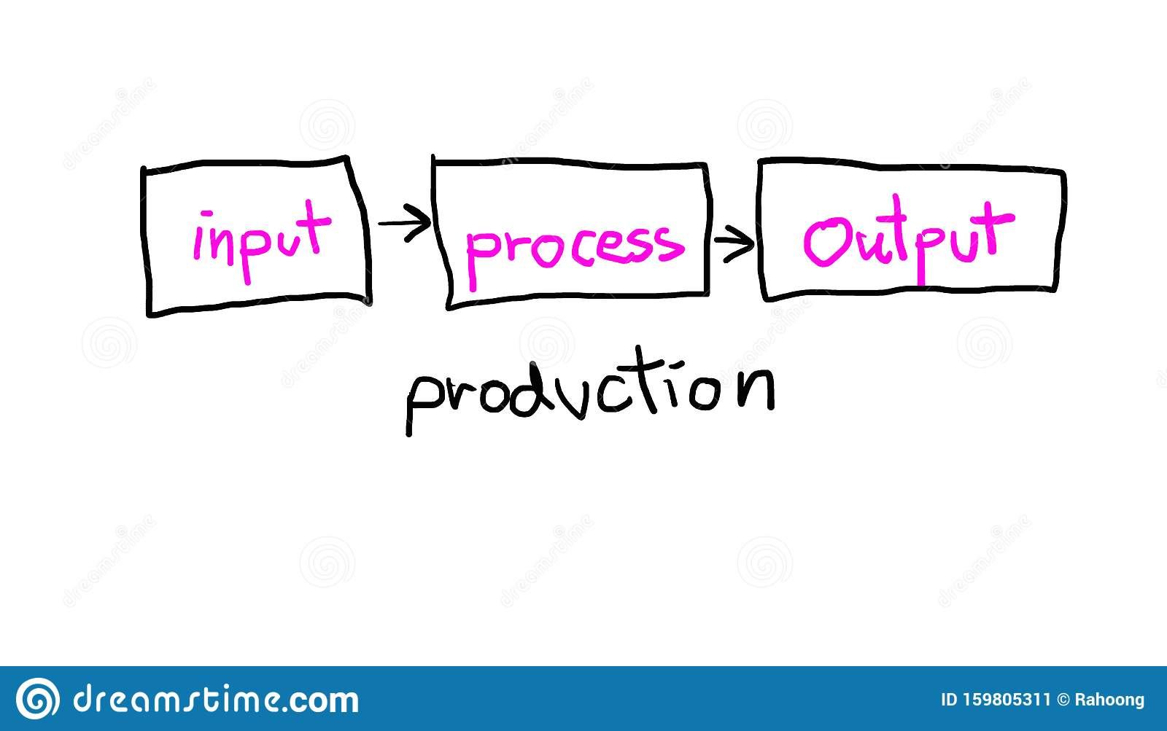
Why the external environment is dynamic?
Input: is concerned with the factor of production (ex. Raw materials).
Process: includes two aspects: Technology (to transfer input to output) and HR (who are using such technology).
Output: Product/service
From where we can get raw material? From where we can get Technology and recruiting HR? and finally, organizations target to serve whom? The answer is (the external environment).
Therefore, the conclusion is any organization cannot ignore the external environment, otherwise it will be out of the market, as the performance will be affected negatively.

Slide 12
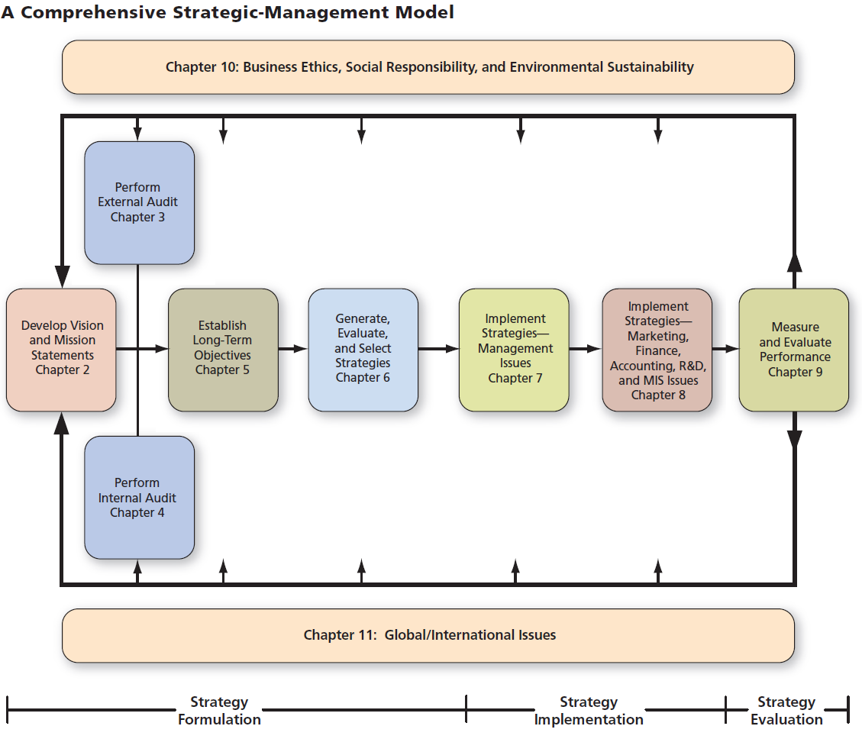
Strategic management process

Slide 13
Strategy formulation
Sometimes strategy formulation is called ‘strategic planning’.
1- Developing a vision and mission,
2- Identifying the external opportunities and threats, simultaneously with
3- Determining the internal strengths and weaknesses,
4- Establishing long-term objectives,
5-Generating alternative strategies, and finally
6-Selecting the strategy.

Slide 14
Strategy formulation
is the process of establishing the organization’s objectives, and choosing among alternative strategies.
Strategy-formulation issues include: deciding what new businesses to enter, what businesses to avoid, how to allocate resources, whether to expand operations or diversify, whether to enter international markets, and whether to merge or form a joint venture.
Strategists must decide which alternative strategies will benefit the firm most.
Strategy-formulation decisions commit an organization to specific products, markets, resources, and technologies over an extended period of time.

Slide 15
Strategy Implementation
1- Developing the annual objectives,
2- Developing the policies,
3- Motivating employees, and
4- Allocating the resources

Slide 16
Strategy Implementation
is the action stage of strategic management. It refers to decisions that are made to install new strategy or reinforce existing strategy. The basic strategy – implementation activities are working on achieving the objectives, and allocating resources.
Strategy implementation also includes the making of decisions with regard to matching strategy and organizational structure, developing budgets, and motivational systems.
Strategy implementation includes creating an effective organizational structure, redirecting marketing efforts, preparing budgets, developing and utilizing information systems, and linking employee compensation to organizational performance.

Slide 17
Strategy Implementation
Implementing strategy means mobilizing employees and managers to put formulated strategies into action.
Often considered to be the most difficult stage in strategic management, strategy implementation requires personal discipline, commitment, and sacrifice.
Successful strategy implementation depends upon managers’ ability to motivate employees, which is more an art than a science, i.e. Interpersonal skills are especially critical for successful strategy implementation.
Every division and department must decide on answers to questions, such as “What must we do to implement our part of the organization’s strategy?” and “How best can we get the job done?” The challenge of implementation is to stimulate managers and employees throughout an organization to work with pride and enthusiasm toward achieving stated objectives.

Slide 18
Strategy evaluation
1- Conducting internal review (weaknesses and strengths),
2- Conducting external review (opportunities and threats),
3- Measuring performance, and
4- Taking corrective action- if needed.

Slide 19
Strategy evaluation
It is the final stage in strategic management.
When managers need to know when particular strategies are not working well; strategy evaluation is the primary means for obtaining this information.
All strategies are subject to future modification because external and internal factors are constantly changing.
Strategy evaluation is needed because success today is no guarantee of success tomorrow! As success always creates new and different problems.

Slide 20
Key concepts in Strategic management
Competitive advantage
Strategists
External opportunities and threats
Internal strengths and weaknesses
Long-term objectives
Annual objectives
Strategies

Slide 21
Competitive advantage
Simply, it is something that I have, and my competitors don’t have.
It is anything that a firm does well compared to its competitors.
Strategic management targets gaining and maintaining a sustainable competitive advantage. Why sustainable??????

Slide 22
Competitive advantage
Normally, a firm can sustain a competitive advantage for only a certain period due to rivals who will imitate and undermine that advantage. Thus it is not adequate to simply obtain competitive advantage.
Hence the company needs to continually adapt to changes in external trends and events and internal capabilities, competencies, and resources

Slide 23
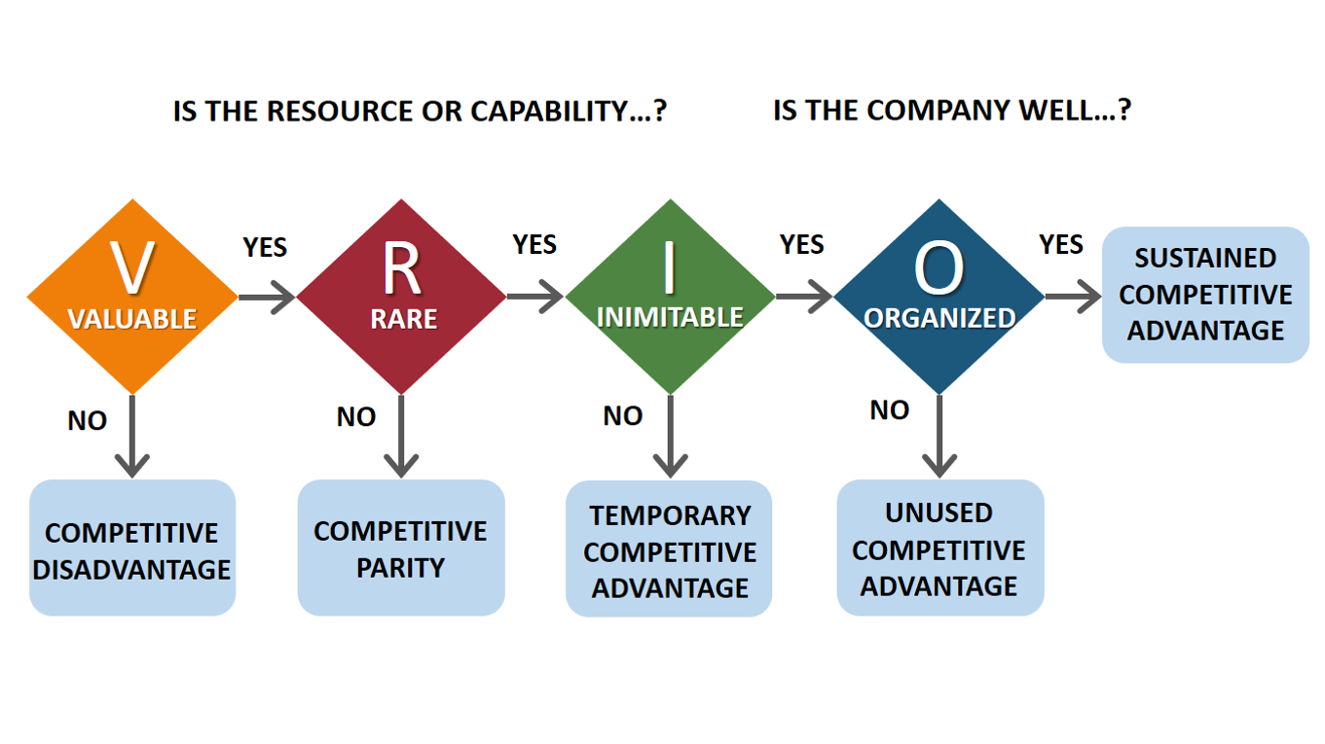
VRIO is a strategic tool used to evaluate a company’s resources & capabilities to determine whether they create a sustainable competitive advantage.
VRIO stands for: V – Valuable/ R – Rare/ I – Inimitable (Costly to imitate)/ O – Organized (used) to capture value
Organized” means the company is able to actually use this advantage in real life.
Without the right organization, the resource stays unused.
The logic is: A firm gains advantage when it owns resources that are valuable, rare, hard to copy, and supported by the organization.

Slide 24
Example: Apple Inc.
VRIO can be applied to one of Apple’s key resources: its integrated system of products and services (iPhone, iOS, App Store, etc.)
V – Valuable: Apple’s integrated system enhances customer experience, increases loyalty, and allows the company to charge premium prices, thus creating significant value.
R – Rare: Few competitors offer such a highly coordinated and seamless integration between hardware and software, making it a rare capability.
I – Inimitable (Costly to imitate): Competitors such as Samsung and Google find it difficult to replicate this level of integration due to Apple’s unique design, brand reputation, and long-term customer relationships.
O – Organized to capture value: Apple is effectively structured and managed to fully exploit this integrated system through its operations, marketing, and supply chain.

Slide 25
Strategists
People who are responsible for:
Gathering Information
Analyzing Information
Organizing Information
(CEO, President,…..)
In order to select the most suitable strategy

Slide 26
External Opportunities and Threats
It means the analysis of trends that could significantly benefit or harm the organization.
Economic conditions
Socio-Cultural circumstances
Demographic/Environmental aspects
Political, Legal, Governmental issues
Technological effect
Competitors

Slide 27
External Factors

Slide 28
External Opportunities and Threats
These factors are uncontrollable, hence, all organization while doing the strategic management, they strive to:
1- Take the advantage of the external opportunities
2- Avoid/ minimize the impact of the external threats.
How can I equip the organization to have this ability ?
It can be done in the strategy formulation stage to handle the opportunities and threats through the best fit between its internal and external factors.

Slide 29
Internal Strengths and Weaknesses
Mostly, these factors are more controllable than the external ones.
These are the activities that performed well (strengths) or poorly (weaknesses).
Whenever we determine our strengths and weaknesses, I put it into a relative way, i.e. compared to the competitors.

Slide 30
Internal Strengths and Weaknesses
What are the main issues that I need to audit internally? In other words where are the internal Strengths and Weaknesses located?
1- Management functions
( Planning- Organizing- Leading- Controlling).
2- Business functions; such as
Marketing
Finance/Accounting
Production/Operations
Research & Development
Management Information Systems
3- Resources that the company has an access to (e.g. financial rescources, HR,….).
Any one of these three main issues could be a source of strengthes or weaknesses

Slide 31
Internal Audit (Internal +ves and –ves)
Resources that the company has an access to can be classified into two groups:
1- Traditional resources: they can be divided into:
Physical resources (building).
Monetary resources (cash, accounts recievables).
2- Intellectual capital resources can be divided into:
Human capital resources (not HR): refers to features and attributes that people have and cannot replaced by machines (knowledge, the level of motivation, experiences, skills, abilities, training, etc…).
Relational resources: the relationship between the organization itself and the stakeholders (customers, suppliers, creditors, government, competitors).
Organizational resources: the structure of the company, the culture, processes, information systems, procedures, regulations, policies, etc…..
When I audit company internally I have to audit all of them.

Slide 32
Long-Term Objectives (more than one year)
They help me to put the strategy into an action.
They are specific results that an organization seeks to achieve in pursuing its basic mission
They provide the basis for planning, organizing, leading, and controlling.
They focus on the coordination among people and aid in their evaluation.

Slide 33
Annual Objectives
Short-term milestones that firms must achieve to reach long-term objectives.
Annual objectives are especially important in strategy implementation, whereas long-term objectives are particularly important in strategy formulation.
Objectives should be SMART

Slide 34
SMART Objectives
S
S
Specific
M
M
Measurable
A
A
Attainable
R
R
Relevant
T
T
Time bound

Slide 35
Strategies
They are the means by which long-term objectives will be achieved.
Examples of strategies;
Geographic expansion,
Diversification,
Acquisition,
Product development,
Market penetration,
Joint venture.

